Slide 1


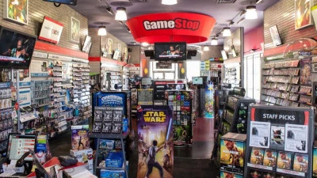
Game shop
Made by Viktor VelIZarov , IVAN PARASHEKVOV , GEORGI KANEV AND
STEFAN GANCHEV

Slide 2
ABOUT THe TEAM
Name | Role
Viktor Velizarov Velizarov - IX V VVVelizarov18@codingburgas.bg | Manager
Stefan Plamenov Ganchev - IX A SPGanchev18@codingburgas.bg | Developer
Ivan Stankov Parashkevov - IX A ISParashkevov18@codingburgas.bg | Developer
Georgi Borislavov Kunev - IX B GBKunev18@codingburgas.bg | Developer

Slide 3
About the project
The idea of our project is to create a program which will be used to help cashiers at stores which sell videogames. Cashiers using it can keep track of purchases and edit them using the edit menu. If they made a mistake while adding a purchase they can also delete it. You can also see different reports from the report menu. If u want to quit the program u can use the final function on the main menu.

Slide 4
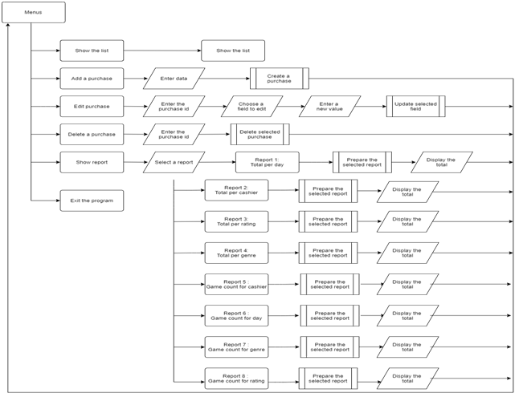
Logical scheme of our application

Slide 5


Used technologies

Slide 6
Future improvements
Add more reports to the reports menu
Translate the menus in different languages
Optimize the code so it loads faster

